Slide 1

.NET Standard: One Library to Rule Them All
Carlos Matías Dieguez
Christian Echagüe
Software Architect
Project Manager
Tecnocode

Slide 3

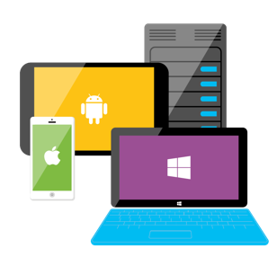







ASP.NET
Azure
Innovation
Open Source
Any app, any platform

Slide 4

C# is an elegant, type-safe, object-oriented, state of the art programming language that run on the .NET Framework
Run on 2.6 billion devices.
With C# and Visual Studio, you can share the same code on iOS, Android, Windows, Mac and more.
C#
Write C#. Create Apps, Webs, Games and Services for all major OS, like Windows, Linux, OSX

Slide 5
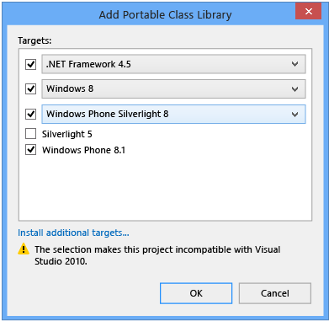
Before .NET Standard: Portable Class Library
Profile based
You must select target platforms
Small Common Denominator
Intersection of features

Slide 6



One Library to Rule Them All
.NET Framework
.NET Core
Xamarin
Application Models
WPF
ASP.NET 4.6
Win Forms
Universal Windows Apps 10.1
ASP.NET Core 2.0
Android 7.0
iOS 10.4
Mac 3.0
.NET Standard Library Based on .NET Standard
One Library to Rule Them All
Base Libraries
Base Class Library
CoreFX
Mono BCL
Common
Runtime Components
Compilers
NuGet packages
Next gen JIT (RyuJIT)
SIMD
Roslyn
.NET Compiler Platform
.NET Core 2.0 Libraries
.NET Framework 4.6 Libraries

Slide 7
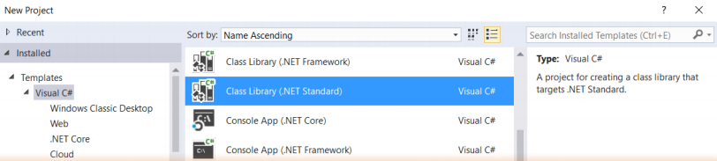
What is .NET Standard?
.NET Standard is a Specification
Represents a set of APIs that all .NET platforms have to implement
Is a type of class library provided as NuGet package

Slide 8
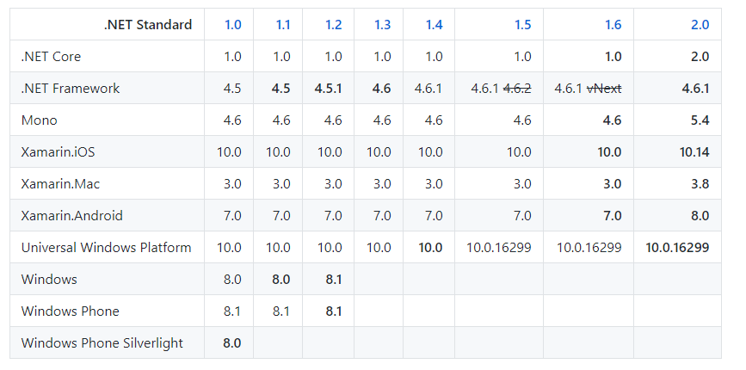
.NET Standard Versions

Slide 9
.NET Standard Versions
2.0
1.6
1.3
1.0
Each version:
Additive
Immutable

Slide 10
.NET Standard 2.0
Introduces more APIs
Creates compatibility with .NET Framework libraries
Version | #APIs | Growth %
1.x | 13,501 | +1%
2.0 | 32,638 | +142%
XML
XLinq • XML Document • XPath • Schema • XSL
SERIALIZATION
BinaryFormatter • Data Contract • XML
DATA
Abstractions • Provider Model • DataSet
NETWORKING
Sockets • Http • Mail • WebSockets
IO
Files • Compression • MMF
THREADING
Threads • Thread Pool • Tasks
CORE
Primitives • Collections • Reflection • Interop • Linq

Slide 11
Benefits
Reuse Skills
Master one library, not each platform.
Reuse Code
Put common code across projects as NuGet packages
Contribute to .NET community with more libraries
Faster innovation
Use social coding & open source to improve code quality and features
Reach new business & clients
Any App, Any Platform

Slide 12

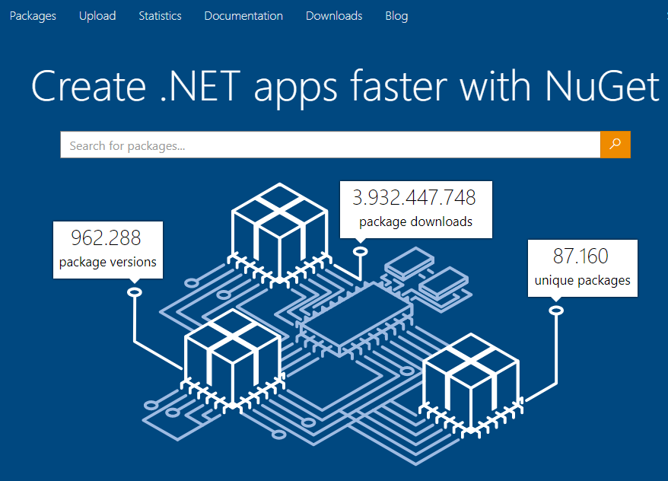

NuGet is the package manager for .NET. The NuGet client tools provide the ability to produce and consume packages. The NuGet Gallery is the central package repository used by all package authors and consumers.

Slide 13
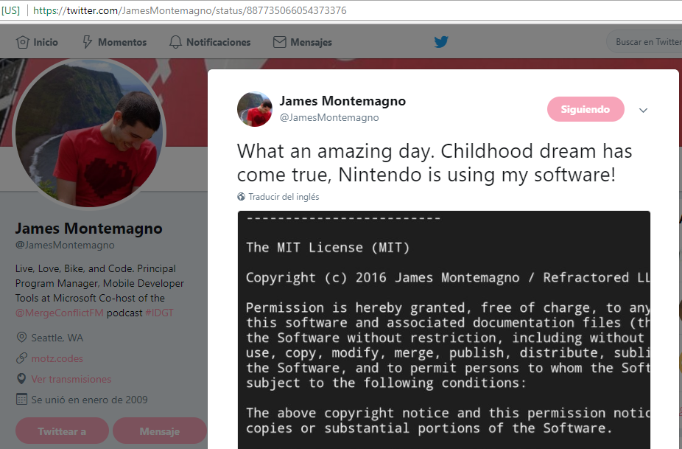
Great achievements with .NET Standard & NuGet

Slide 14


Workshop’s goals
.NET Core
.NET Standard
API Client
GitHub
AppVeyor

Slide 15
Hands on Lab I
https://github.com/matiasdieguez/netstandard-workshop/blob/master/docs/lab-1.md
En este Lab repasamos los primeros pasos para trabajar con GitHub, una plataforma de desarrollo colaborativo para alojar proyectos utilizando el sistema de control de versiones Git.

Slide 16
Hands on Lab II
https://github.com/matiasdieguez/netstandard-workshop/blob/master/docs/lab-2.md
En este Lab utilizaremos el nuevo repo creado en el Lab I para hostear un proyecto de biblioteca .NET Standard que implemente un cliente tipado para la API que cada coder elija y la publicaremos como un paquete en nuget

Slide 17
Hands on Lab III
https://github.com/matiasdieguez/netstandard-workshop/blob/master/docs/lab-3.md
En este Lab crearemos proyectos en distintas plataformas .NET para implementar nuestros paquetes .NET Standard.

Slide 18
Hands on Lab IV
https://github.com/matiasdieguez/netstandard-workshop/blob/master/docs/lab-4.md
En este Lab dotaremos a nuestro proyecto de Integración Continua utilizando AppVeyor.

Slide 19
Thank you!
Carlos Matías Dieguez
Christian Echagüe
matias.dieguez@tecnocode.net
christian.echague@tecnocode.net
@dieguezrojo
@echaguechris
www.tecnocode.net

